Slide 1
ENTSOG Capacity
Development of the CAM NC – progress and next steps
Brussels – 20th October 2011

Slide 2
Introduction - Objectives
Describe needed changes to be included into final NC from draft
  As a result of final ACER FG
  Following market consultation on draft NC
Update on progress regarding CAM NC development
Explain next steps
Ensure participants are fully informed about the key issues and are well placed to engage in the CAM NC process

Slide 3
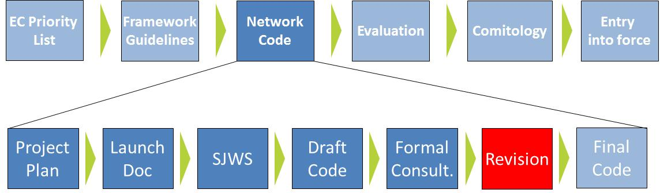
Project progress
Stakeholder Workshops
1. 9th February
2. 9th March
3. 6th April (SJWS 1)
4. 21st April (SJWS 2)
5. 4th May (SJWS 3)
6. 19th May (SJWS 4)
7. 21st June (draft NC)
8. 20th July (Auction simulation)
9. 6th Oct. (Sunset Clause)
10. 20th Oct. (Code changes)
Additional sessions planned (auction design and further code update)
Project planning
Launch
Doc
SJWS
Publication of draft NC
End of consultation
MF XX & Report published
User Workshop
ERGEG publishes original CAM FG
December 2010
EC sends original invitation letter
27 January 2011
ACER publishes revised CAM FG
August 2011
EC sends updated invitation letter
17 August 2011
Original deadline
27 January 2012
Updated deadline
9 March 2012
Notes:
Key points:
- We are now in the revision stage

Slide 4
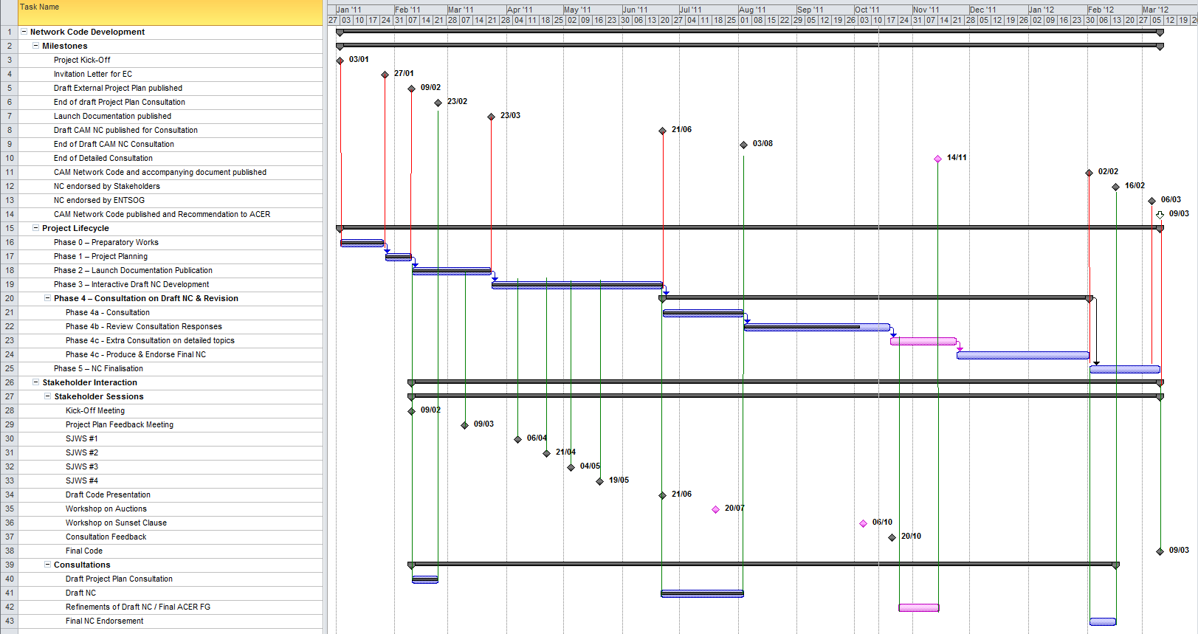
Planning
Use 6 week extension to hold new consultation
Planned progress for reporting period
Achieved progress or delay
today

Slide 5
Recent developments
3rd August 2011: Revised ACER FG published
3rd August 2011: Draft CAM NC consultation closed
17th August 2011: New invitation received from EC
  New code deadline = 9th March 2012
26th Sept 2011: Consultation Analysis Report published
6th October 2011: Stakeholder workshop on Sunset Clause

Slide 6
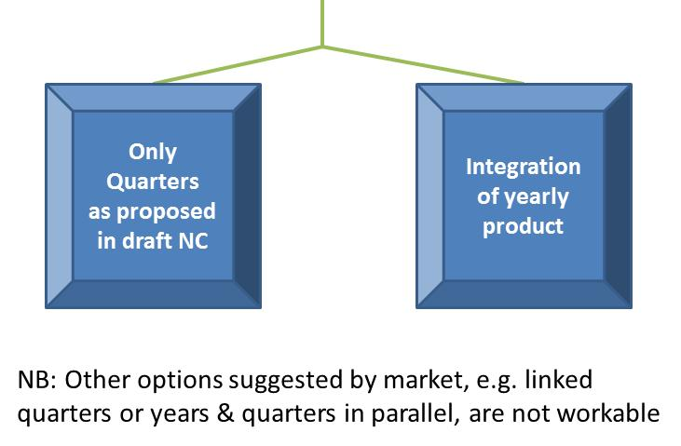
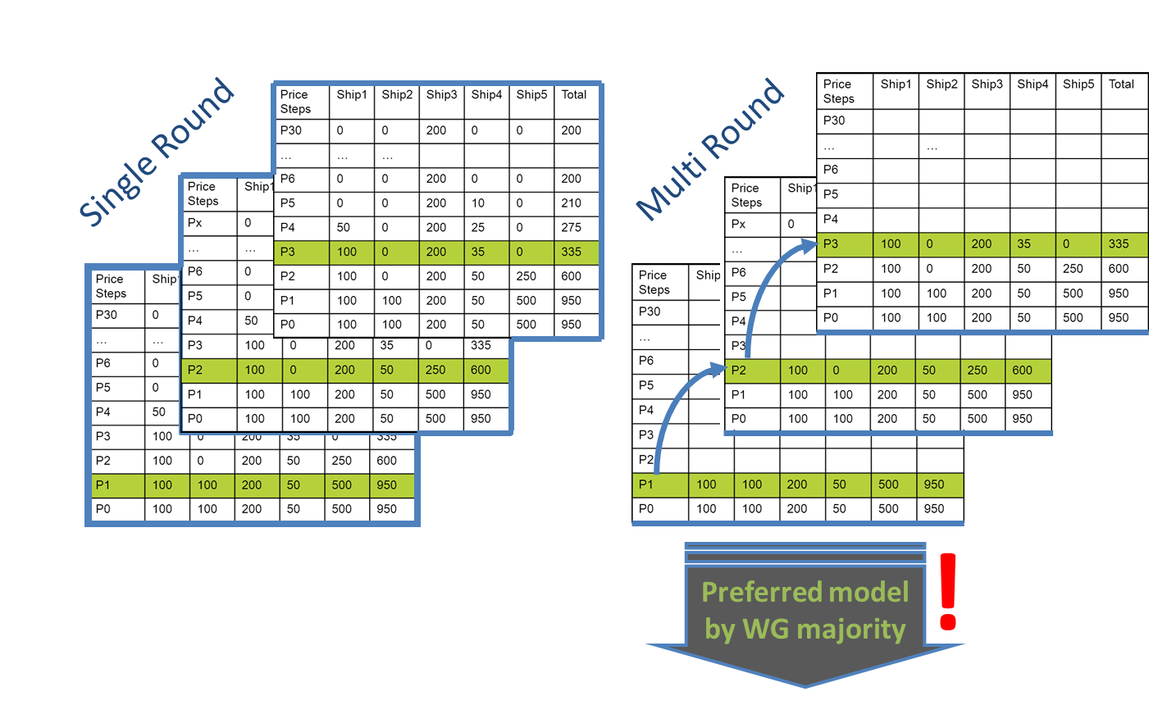
New consultation – after market feedback
Products
Auction Design

Slide 7
New consultation – after new ACER CAM FG
To be included in final ACER CAM FG
Exclusive Bundling
Draft included in CAM NC
No modifications requested
Sunset Clause
Text developed to reflect the FG requirement
Currently under WG development
!
Default Rule
Options developed internally for discussion with market
Consultation will be published on 24th October

Slide 8
Stakeholder comments on the CAM NC process
Great satisfaction with transparency and inclusiveness of process
Criticism on issues:
  Parallel ACER FG consultation and Target Model process were not helpful;
  Parallel process challenges arising from CAM, CMP and Target Model
Many valuable suggestions for future code processes
ENTSOG considers for CAM: e.g. email alerts for docs and events, and other suggestions
Great expectations by the market
CAM NC process considered a good model for future codes

Slide 9
Handbook debate
Update from discussion with EC
In Madrid Forum Users, Commission, (ACER), Member States and ENTSOG supported the idea of handbooks
EC lawyers’ initial thinking:
  NCs cannot make references to other documents to generate binding nature – seen as way around Comitology
  Handbooks possible, but have to run through Comitology as well
ENTSOG may consider if independent handbook(s) that all TSOs implement could be developed
Flexible code modification process to be further discussed

Slide 10
Next steps
Milestone | Date
Second market consultation on CAM NC concepts | 24th October – 14th November 2011
Finalisation of NC text and accompanying document within Capacity Working Group | November – December 2011
Stakeholder update session | December 2011
ENTSOG Board approval | January 2012
Stakeholder support process | 2nd – 16th February 2012
ENTSOG General Assembly approval | March 2012
Final NC submitted to ACER | 9th March 2012

Slide 11
Conclusions 1
Products
ENTSOG will recommend to consider a yearly or a quarterly product for longer term sales
Auction design
ENTSOG will consult on both single and multiple round models
Consideration of unlimited price steps
Mechanism to avoid undersell
Sunset Clause
Sunset Clause work in progress
Default Rule options to be consulted

Slide 12
Conclusions 2
Interruptible capacity
Interruptible allocations follows firm procedure
Interruption procedure clarified (time stamp, then pro-rata)
Reasons for interruptions (non-exhaustive list)
Tariffs
Reserve price = regulated tariff
Floating vs. fixed price, split of auction revenues,
over and under recovery, etc.
Handbook
Work assuming there is no handbook but code modification critical

Slide 13
Thank You

Slide 14
Back Up

Slide 15
ENTSOG Capacity Workshop
Set of Capacity Products and Auction Algorithm
20th October 2011

Slide 16
AGENDA
Set of Capacity Products
Set of products to be auctioned in the light of consultation outcomes and consequent allocation process
Auction Algorithm
2.1 Single-round approch including stability measures
2.2 Multiple round approach ascending clock auction
2.3 Measures for avoiding undersell

Slide 17
1. Set of Capacity Products

Slide 18
Capacity products: consultation results
Alignment with ENTSOG proposal
Not clear
Half and half
No response
Integration of annual products
Stakeholders:
Yearly products should be included
Not too many auctions, keep it simple

Slide 19
Options – Set of Products
New consultation to be launched on 24th October 2011 will describe two options:
1
Long term capacity sold as
quarterly only
Consequences
Long-term QP
Annual MP
Rolling MP
Rolling DP
Allows seasonal profiling of products more than 1 year ahead
Can be used to build up a contract of any duration
Does not answer consultation respondents’ requests for inclusion of yearly product
10% of capacity reserved for short term can be sold up to a year ahead.
2
Integration of Yearly product
Long-term YP (substitute LT QP)
Annual QP (substitutes Annual MP)
Rolling MP
Rolling DP
Answers respondents’ requests for inclusion of yearly product
Fewer auctions
Some loss of flexibility (can’t build seasonally profiled product more than a year ahead)
Requires EU-wide harmonization of start date for yearly product
10% of capacity reserved for short term is sold month ahead.
Other possibilities not considered appropriate, for example:
Yearly product only, no quarterly
“Linked quarters”
Auction yearly and quarterly at same time
Auction quarterly for the next available years, then annual for later years

Slide 20
Recommendation:
ENTSOG recommends Option 2 (integrate yearly product)
Have developed a workable proposal in response to market requests
But will consult further on the two options described

Slide 21
2. Allocation Mechanism

Slide 22
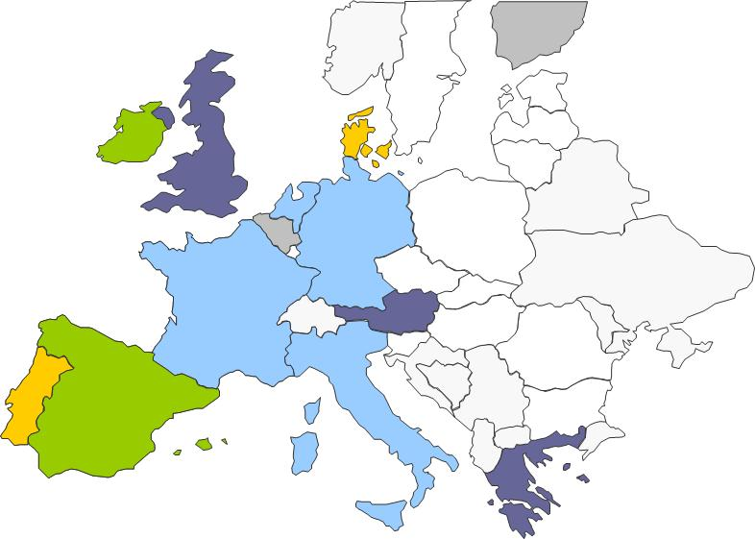
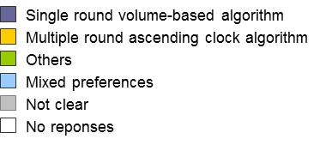
Auction design
Almost all agree that long term auction design needs modification
  Reflects difficulties observed at workshop on 20th July
Respondents divided on most appropriate LT design.
Two options are the most supported:
  Introducing stability measures to current code proposal
  Implementing a multi-round ascending-clock algorithm
22

Slide 23
2. Allocation Mechanism
2.1 Single-round model
Stability measures
Price discovery measures

Slide 24
Single-round model as initially proposed
One bidding round with defined (and limited) number of price steps
  Bidders bid volumes against announced prices
Auctions ends at predefined point of time
  Bidding opening time + x days
Publication of aggregated demand within the round (price discovery)
Bidders are allowed to freely review their bids until last moment
Pro-rata at highest price step
Value of capacity cannot be validated due to freedom to review bids, however stability measures can address this problem
Pro-rata implies unwanted results
Single round model can be refined, to achieve better value discovery in line with multiple round ascending clock model
24

Slide 25
Stability/Value Discovery measures (1/2)
A) Early Closure of Bidding Window
Objective is to reveal a fair and true valuation from day 1
Early closure when stability in demand is reached or if demand is lower or equal to offer
Similar to ascending clock where auction closes when demand is lower or equal to offer
Proposal:
“immediate closure rule”: BW closes after D₁ if CP_{D1} = P₀ (this means demand ≤ offer on the first day)
“early closure rule”: BW closes if clearing price is unchanged from one day to the next
25
25

Slide 26
Stability/Price Discovery measures (2/2)
B) Limitation of bid revision
Enforce binding character of a bid
In ascending-clock, you can choose to stay in the next round or step out.
  If auctions closes, you can’t step out
  If auction continues, you can decide to keep the requested volume or reduce it (eventually to 0), not raise it → the initial demand is the max
Such revision cannot lead to the price suddenly “reducing”
How binding is the bid on Day 1 if it can be freely amended, upwards or downwards?
Price elasticity of demand does not change within the bidding window
  The bidder would accept every quantity on the individual demand curve independently from other points
Proposal:
Quantity bid at any one price step cannot increase from one day to the next
26
26

Slide 27
2. Allocation Machanism
2.2 Multi-Round Model
Multiple round ascending clock model

Slide 28
Multiple-round model
Several binding bidding rounds with ascending prices
Bidders bid volumes against successively announced prices
Auctions ends as soon as demand ≤ supply
Number of bidding rounds not defined, but quick convergence ensured through different/adjustable price steps
Value of capacity can be validated due to publication of aggregated demand after each round
Sold capacity can be lower than supply since demand can decrease significantly between rounds; small price steps can reduce this risk

Slide 29



Ascending clock approach
Shipper 1
Price step | Quarter 6 (just as an example)
 | Avail. qty | S1 | S2 | ∑
5 | 120
4 | 120
3 | 120
2 | 120
1 | 120
1 Bid
1 Bid
Bidders need to actively place bids at every price step as long as they want to stay in the game
Shipper 2

Slide 30
Ascending clock approach
Shipper 1
Price step | Q6
 | Avail. qty | S1 | S2 | ∑
5 | 120
4 | 120
3 | 120
2 | 120
1 | 120 | 120 | 100 | 220
1 Bid
Announced price step
1 Bid
Shipper 2

Slide 31
Ascending clock approach
Shipper 1
Price step | Q6
 | Avail. qty | S1 | S2 | ∑
5 | 120
4 | 120
3 | 120
2 | 120 | 100 | 80 | 180
1 | 120 | 120 | 100 | 220
1 Bid
Announced price step
1 Bid
Shipper 2

Slide 32
Ascending clock approach
Shipper 1
Price step | Q6
 | Avail. qty | S1 | S2 | ∑
5 | 120
4 | 120
3 | 120 | 80 | 60 | 140
2 | 120 | 100 | 80 | 180
1 | 120 | 120 | 100 | 220
1 Bid
Announced price step
1 Bid
Shipper 2

Slide 33
Ascending clock approach
Shipper 1
Price step | Q6
 | Avail. qty | S1 | S2 | ∑
5 | 120
4 | 120 | 70 | 40 | 110
3 | 120 | 80 | 60 | 140
2 | 120 | 100 | 80 | 180
1 | 120 | 120 | 100 | 220
1 Bid
Announced price step
1 Bid
Auction clears once aggregated demand < supply
Shipper 2

Slide 34
Ascending clock approach
Shipper 1
Price step | Q6
 | Avail. qty | S1 | S2 | ∑
5 | 120
4 | 120 | 70 | 40 | 110
3 | 120 | 80 | 60 | 140
2 | 120 | 100 | 80 | 180
1 | 120 | 120 | 100 | 220
1 Bid
Announced price step
1 Bid
Auction clears once aggregated demand ≤ supply
Shipper 2

Slide 35
Recommendation:
ENTSOG will consult on both single and multiple round models without making a recommendation

Slide 36
2. Allocation Mechanism
2.3 Number of price steps

Slide 37
Number of price steps
For either single or multiple round models:
Some consultation respondents argued that number of price steps should be unlimited in order to avoid pro rata at the highest price step.
Assuming incremental capacity not in scope of CAM, the options are:
  Unlimited price steps (describe the price steps, but will leave the number of price steps open)
  Limit the number of price steps and allow pro-rata at the highest price step if demand > supply
Recommendation: Unlimited price steps
This approach limits or avoids the need to apply any pro-rata at the highest price step while still being volume-based auctions in which users place volume-bids against a range of prices.

Slide 38
2. Allocation Mechanism
2.4 Measures for avoiding undersell

Slide 39
Small price steps
In order to minimise underdemand while avoiding the application of a pro-rata rule, smaller price steps could be announced
In order to save time, multiple price steps could be announced per round
Note: this is shown applying to a multiple round auction. For single round the principle is the same but the system is much simpler: shippers would bid against small price steps during the bidding window
Round | Price step | Q6
 |  | Avail. qty | S1 | S2 | ∑
5 | 15 | 120
 | 14 | 120
 | 13 | 120
4 | 12 | 120
 | 11 | 120
 | 10 | 120
3 | 9 | 120
 | 8 | 120
 | 7 | 120
2 | 6 | 120
 | 5 | 120
 | 4 | 120
1 | 3 | 120 | 110 | 85 | 195
 | 2 | 120 | 115 | 90 | 205
 | 1 | 120 | 120 | 100 | 220
S1
1 Bid
Bid list
S2

Slide 40

Small price steps
Round | Price step | Q6
 |  | Avail. qty | S1 | S2 | ∑
5 | 15 | 120
 | 14 | 120
 | 13 | 120
4 | 12 | 120
 | 11 | 120
 | 10 | 120
3 | 9 | 120
 | 8 | 120
 | 7 | 120
2 | 6 | 120 | 85 | 65 | 150
 | 5 | 120 | 90 | 70 | 160
 | 4 | 120 | 100 | 80 | 180
1 | 3 | 120 | 110 | 85 | 195
 | 2 | 120 | 115 | 90 | 205
 | 1 | 120 | 120 | 100 | 220
S1
1 Bid
Bid list
S2

Slide 41
Small price steps
Smaller price steps result in a smoother shape of the demand curve and limit the probability of underdemand (e.g. no underdemand at all at the clearing price in this example)
More price steps per round allow for faster allocation (e.g. in round 3 instead of round 4)
Round | Price step | Q6
 |  | Avail. qty | S1 | S2 | ∑
5 | 15 | 120
 | 14 | 120
 | 13 | 120
4 | 12 | 120
 | 11 | 120
 | 10 | 120
 | 9 | 120 | 75 | 45 | 120
3 | 8 | 120 | 80 | 50 | 130
 | 7 | 120 | 80 | 60 | 140
2 | 6 | 120 | 85 | 65 | 150
 | 5 | 120 | 90 | 70 | 160
 | 4 | 120 | 100 | 80 | 180
1 | 3 | 120 | 110 | 85 | 195
 | 2 | 120 | 115 | 90 | 205
 | 1 | 120 | 120 | 100 | 220
S1
1 Bid
Bid list
S2

Slide 42
Allocation of all capacity
The draft version of the NC on CAM establishes the auctions’ clearing price as follows:
  “All bids at the lowest price at which total demand is less than or equal to the available quantity shall be allocated the capacity requested […]”
This implies that once the auction has been held, in most cases, not all the available capacity will be allocated even if there has been enough demand at the previous price step.
42

Slide 43
Allocation of all capacity
The clearing price is the highest price (P_{x}) for which total demand is higher than or equal to the available capacity offered.
All network users having placed bids at such P_{x} will be allocated as follows:
  If network users have bid at the subsequent price-step (P_{x+1}), all quantity requested at P_{x+1} shall be allocated to those bidders
  The remaining quantity to be allocated, being the difference between the available capacity offered and the total demand at P_{x+1}, shall be distributed amongst bidders at P_{x}, proportionally to the difference between their requested quantity at P_{x} and P_{x+1}.
43

Slide 44
Allocation of all capacity
450 units offered
Clearing price for all shippers: P2
Total units allocated: 450
Shipper 1
Shipper 1
Shipper 2
Shipper 2
Shipper 3
Shipper 3
Shipper 4
Shipper 4
Shipper 5
Shipper 5
Total
Total
All the units offered are allocated
450
Allocation
450
Allocation
100
100
0
0
+
+
16.7
200
200
25
25
+
+
8.3
100
100
All capacity requested at P3 is allocated
Capacity requested at P2 is allocated by pro
-
rata

Slide 45
Recommendation:
ENTSOG will consult on whether to introduce both measures (within either a single or multiple round auction)

Slide 46
ENTSOG Capacity Workshop
The Sunset Clause
20th October 2011

Slide 47
ACER CAM FG: Sunset Clause
Sunset Clause
All contracts to be transferred into bundled contracts 5 years after the implementation
  First attempt to reach agreement by involving all parties
  If this isn’t possible, then apply the Default Rule (splitting rule)
Shipper 2
Shipper 1
y units booked
VTP2
VTP1
x units booked
Shipper 3
z units booked

Slide 48
ACER CAM FG: Sunset Clause
Shipper 2
Shipper 2
u units booked
u units booked
VTP2
VTP1
Shipper 1
Shipper 1
v units booked
v units booked
Shipper 3
Shipper 3
w units booked
w units booked

Slide 49
Sunset Clause
After ACER CAM FG, ENTSOG is obliged to include the Sunset Clause
Stakeholders, ENTSOG members and GIE are very concerned about the implications
However ENTSOG will work with market participants to develop a Sunset Clause to be included in the final CAM NC
A number of issues must first be resolved
This issue was not covered by the previous CAM NC consultation

Slide 50
Sunset clause: Open Issues
Feasibility to bundle the contracted capacity
  Technical: quantity /multiple scenarios on an IP
  Contractual: duration/multiple actors
Treatment of the remaining unbundled capacity
  Impact on revenues TSO/Shipper
  Introduction of various schemes in parallel:
    contractual: bundled/unbundled product ?
    Commercialisation: auction/other?
Proportionality issue
  Non discrimination principle
Default Rule often likely to be necessary

Slide 51
Sunset clause: Open Issues
Role of the TSOs
  Cooperation of TSOs
  Agreement among shippers /transparency
  Consistency of implementation of agreements
NRAs’ role
  Price of the product/ tariff/ commercialisation process
  Intervention in the process + enforcement
Focus on transmission contract
  Supply agreement set apart
Legal issues
  Substantial issues still to be resolved e.g. translation of agreement(s) into contracts

Slide 52
Default rule
When no agreement of the split between active shippers, a default rule shall apply in order to split capacity between original capacity holders proportionally to their capacity rights
Questions to be answered in a 3-step-approach
Step
Question
Action
Step 1
What capacity is
to be bundled?
Define what capacity is to be divided and allocated proportionally amongst concerned shippers
Step 2
How is not matching capacity treated?
Define how not matching capacity
units are to be treated
Step 3
What does
proportionally mean?
Determine a mathematical formulation
about what “proportionally” means

Slide 53
Default rule – general principles
ENTSOG considers that any default rule should be based on the following principles
Ensure a proportional and non discriminatory allocation of bundled capacity, in line with the requirements of the Framework Guideline; and
Be without any room for interpretation; and
Technical constraints shall always restrict the maximum amount of capacity to be bundled at a specific IP, i.e. technical lesser-of-rule always to be applied ahead of default-rule application

Slide 54
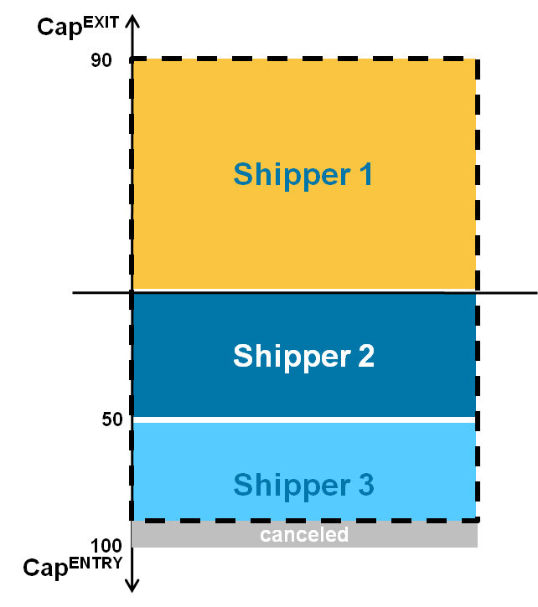
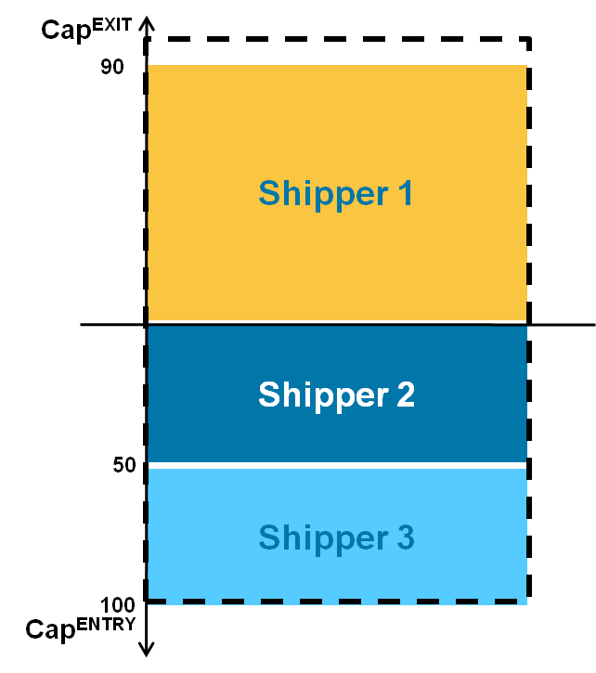
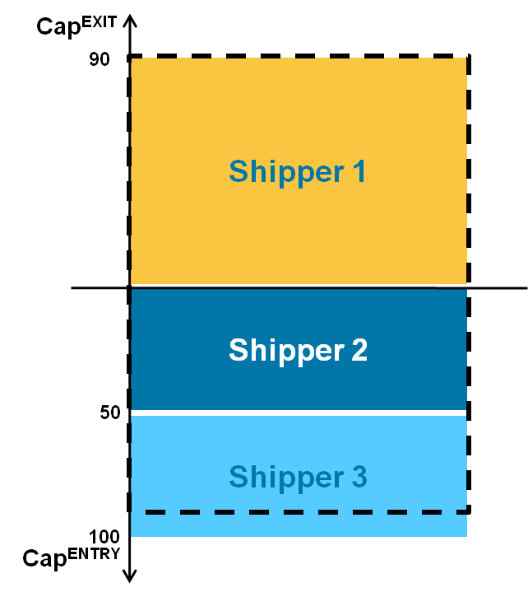
Default rule – Steps 1 & 2
Step 1
What capacity is
to be bundled?
Minimum of aggregated bookings on either side of IP?
Maximum of aggregated bookings on either side of IP?
Step 2
How is not matching capacity treated?
Cancelled?
Filled up with additional capacity?
Remains unbundled?
Theoretical approaches
Minimum default rule
Maximum default rule
Partially unbundled def. rule

Slide 55
Default rule – Step 3
Step 3
What does
proportionally mean?
ENTSOG’s proposal is a pure mathematical formula in order to ensure a proportional split and to eliminate any room for interpretation at the same time
Bundled capacity holdings shipper_{i} after default rule application =

Slide 56
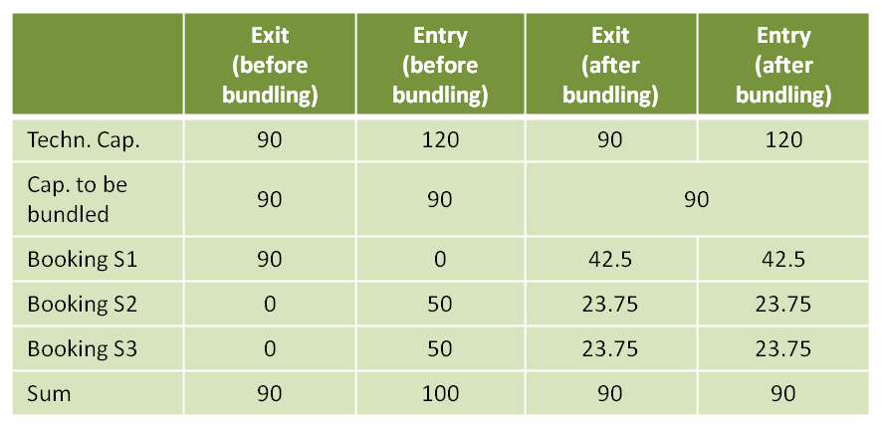
Default rule - Analysis
Minimum default rule approach
Consequences
  Booking levels not maintained
  Risk of under-recovery which would need to be recovered from remaining users
  Capacity booked before will be freed up and might subsequently be offered bundled – though demand is not guaranteed
Conclusion
  Not acceptable either for majority of workshop participants or for TSOs

Slide 57
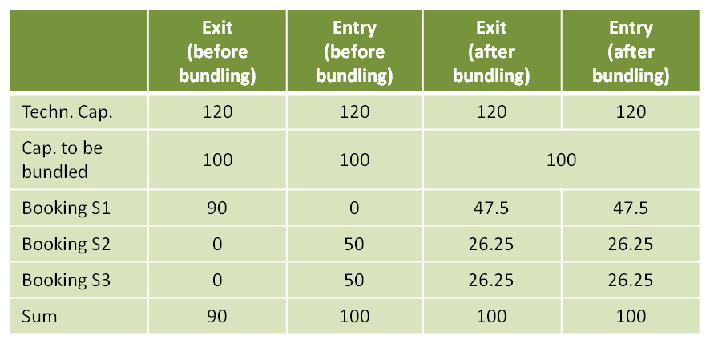
Default rule - Analysis
Maximum default rule approach
Consequences
  Booking level is maintained; some users would be forced to take on additional units of capacity
  No under-recovery issue
  Capacity would be allocated outside the auction process in a potentially discriminatory manner
  In case of technical constraint (restricting maximum capacity to be bundled), alternative approach would be needed
Conclusion
  ENTSOG won´t recommend this approach to the market due to general rejection of sunset clause/default rule
  However, ENTSOG willing to further elaborate on this approach

Slide 58
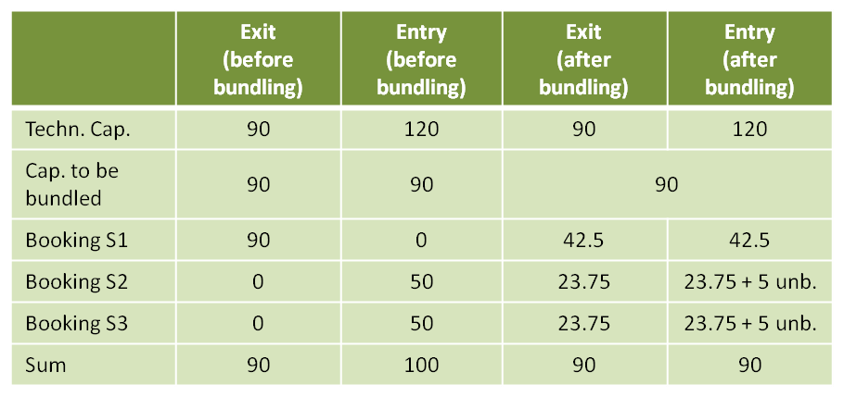
Default rule - Analysis
Partially unbundled default rule
approach
Consequences
  Booking levels are maintained; no user is would be forced to take on additional units of capacity
  No under-recovery issue
  Usefulness of remaining unbundled capacity questionable
  Flange trading may be possible
Conclusion
  Applicability depends on legal feasibility, i.e. if unbundled capacity can exists according to FG or not
    If yes, approach is possible
    If not, remaining capacity needs to be filled up
  ENTSOG won´t recommend this approach to the market due to general rejection of sunset clause/default rule
  However, ENTSOG willing to further elaborate on this approach

Slide 59
Default rule – Open questions
How are more complex issues handled?
  More shippers involved
  Different number of TSOs involved on both sides of the IP
  Same shipper holds capacity on both sides
Are partial agreements possible during negotiations ahead of default rule application?
Can not matching capacity remain unbundled after the application of the default rule?
Will a bundle of firm and interruptible capacity be considered as bundled capacity?

Slide 60
Sunset Clause workshop on 6th October - Conclusions
Most are against the application of the Sunset Clause
No negotiation (already with the simplified scenarios) was successful – the Default Rule would have always been applied
With all Default Rule options it remains unclear if users would not consider legal measures – they may always state to be in a disadvantaged situation compared to the capacity contract they had initially booked
The meeting could not identify an appropriate Default Rule (solutions seem always un-sufficient for some users)
Neither, the negotiations nor any default rule satisfied the users
“Partially Unbundled Rule” to be further elaborated

Slide 61
ENTSOG Capacity Workshop
Interruptible Capacity
20th October 2011

Slide 62
Interruptible Products
Regulation 715/2009:
Art. 16.3a: TSOs shall offer a day-ahead interruptible at IPs where firm capacity is sold out
Framework Guideline:
Alignment, not full harmonisation
The NC includes:
Joint sales process through auctions
Standardised lead time
Coordination of interruption processes
Defined sequence of interruptions
62

Slide 63
Interruptible and Within Day
Market Feedback:
Majority questions the proposed interruption sequence. Respondents believe time stamp approach is complex and discriminatory.
⇨ Pro rata meets both support and resistance.
No clear preference on how interruptible should be allocated
NC should be clearer on interruptible products
KG actions:
Within Day interruptible: FCFS vs Auctions
Better explain the timestamp approach
Include reasons for interruptions
Future role of interruptible uncertain because of impact CMP Guideline

Slide 64
General characteristics
Interruptible capacity services can be offered by TSOs at any IP in both directions.
The minimum obligation posed upon TSOs shall be to offer a day-ahead interruptible service at IPs where firm capacity is sold out
At unidirectional points, backhaul capacity shall be offered at least on an interruptible basis.
If offered, interruptible capacity services shall have the same durations as firm capacity services.
If offered, interruptible capacity shall be allocated via an auction process

Slide 65
Within Day interruptible: FCFS vs Auctions
According to ACER FG Interruptible within day capacity should be allocated by entitling registered network users to submit nominations on an interruptible basis at any time within day.
ENTSOG is not including this process into the NC for reasons of:
Clarity
Implementation costs
Limited added value
Auctioning is market-based, more transparent and just as fast
WG opinion is that a combined solution, as proposed by the FG, would combine the worst of both options and lead to high costs and complexity.
Therefore, either a FCFS or an auction procedure should be applied for within-day, not a both.
ENTSOG preference is for AUCTIONS as is presented in the draft NC.

Slide 66
The timestamp approach
6.4. Defined sequence of interruptions
The order in which interruptions shall be performed is determined by the Contractual Timestamp of the respective Capacity Contracts. The Capacity Contract with the oldest Contractual Timestamp shall prevail.
This means that:
the contract of a longer duration will prevail over a contract with a shorter duration in case of an interruption , as all contracts resulting from the same auction will receive the same time stamp. In effect, this gives an advantage to day-ahead over within-day. After this pro rata is applied.

Slide 67
Reasons for interruption
Article 6.5 Reasons for interruptions
TSOs shall include reasons for interruptions either directly in their interruptible capacity contracts or in the general terms and conditions that govern these contracts.
Reasons for interruptions can include but are not limited to pressure, temperature, flow patterns, use of firm contracts, maintenance, up- or downstream constraints, public service obligations, capacity management deriving from CMP etc.

Slide 68
Impact CMP
Interruptible is a CMP measure aiming to utilise temporarily non-used capacity. Other CMPs aim to do the same thing. Under CAM capacity will be reserved for ST use.
CMP Guideline proposes:
Surrender
Secondary market
Overbooking and buy-back
Restriction of renomination rights (possibly)
ENTSOG foresees a diminishing role for interruptible products

Slide 69
ENTSOG Capacity Workshop
Tariffs
20th October 2011

Slide 70
Tariffs
Essential provisions in the CAM NC
Tariff provisions are necessary to enable CAM rules to work
  Later tariff codification, such as a tariff network code or a Commission guideline on tariffs, might bring more specific rules
  Principle from CAM Framework Guideline: Reserve Price = Regulated Tariff
  However, further principles need to be specified in CAM NC already now:
    Clarification that both a « fixed » and a variable « floating » price regime are possible for the time being
    “Revenue Equivalence Principle”: reserve price structure along product durations (long vs. short term products)
    Split of auction revenues from bundled products
    Clarification that there needs to be over and under recovery mechanisms in place (as appropriate)

Slide 71
Tariffs (1)
Fixed and floating auction prices
    Both « fixed » and variable « floating » price regime shall be possible
Fixed price: In the auction, the payable price is determined as:
Regulated price at the time of the auction + auction premium
potential effect: higher need for over and under recovery mechanisms in the longer run
Variable (floating) price: In the auction, the price is determined as:
Regulated price at the time of potential capacity usage + auction premium
    potential effect: higher uncertainty for users regarding capacity prices in the longer run
For the time being, NRAs and TSOs will have to opt for one of the schemes; no prejudice to further EU discussion

Slide 72
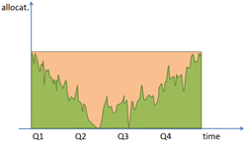
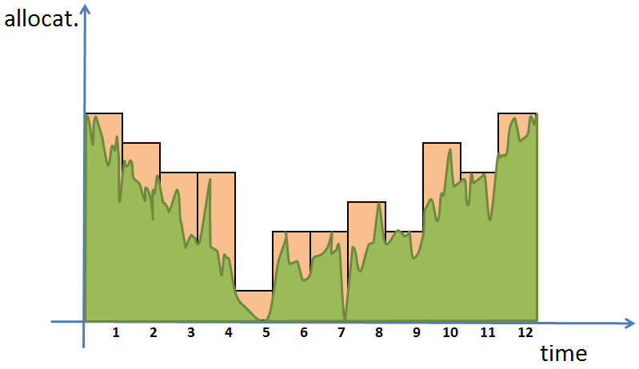
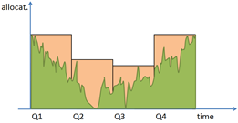
Tariffs (2a)
Regulated reserve prices throughout standard capacity products
Revenue of flat long term booking approximately equal to revenue of profiled booking along actual flows, while not foreclosing sensible seasonal pricing. (Revenue Equivalence Principle)
Aim: Equity for all system users and avoidance of cross-subsidisation

Slide 73
Tariffs (2b)
Achieving equity between users of long and short duration products
  Inherent incentive neutrality of revenue equivalence principle allows system users to procure capacity according to their identified need
    minimises any undue incentives to book long term capacity before such a need is identified and any undue incentives to wait for short term capacity auctions after such a need is identified.
Users who book longer term shall be put on equal footing with those who can book close to time of flow – no undue cross-subsidisation:
  Reserve prices for shorter term products to reflect further profiling opportunity closer to flow
Regulation 715 calls for tariffs not arbitrarily higher or lower than the standard annual tariff (Art. 14 (2))

Slide 74
Tariffs (3)
Split of revenues from auctions of bundled products
Regulated reserve price of a bundled product
= Σ regulated reserve prices of capacities in the bundle
Each TSO invoices the reserve price of their capacity in the bundle from successful bidder
Receivables from auction premiums (when auctions clear above the regulated tariff) will be apportioned according to IP specific agreements. If no agreement is found, the default split will be proportional to the reserve prices.
  A few consultation respondents have noted that a proportional split could entail strange incentives to raise tariffs at congested points. This issue will be re-consulted in the second consultation.
Pragmatic solution for the apportionment of revenues from bundled products

Slide 75
Tariffs (4)
Over and under recovery
  CAM Framework Guideline mentions over recovery – the equally likely event of under recovery should also be reflected
  Over and under recovery mechanisms have to be in place within individual regulatory regimes
  Variety of regulatory regimes and diverse occurrence of, and reasons for, over and under recovery need to be addressed
Clarification that with new products and auctions, over and under recovery needs to be addressed

